Slide 1
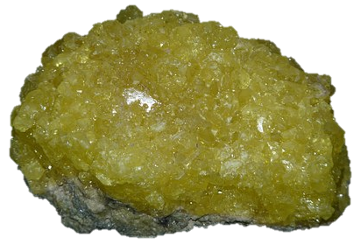
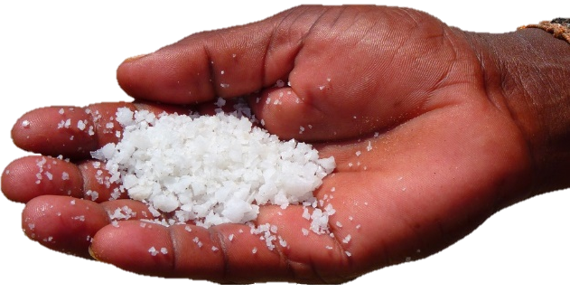
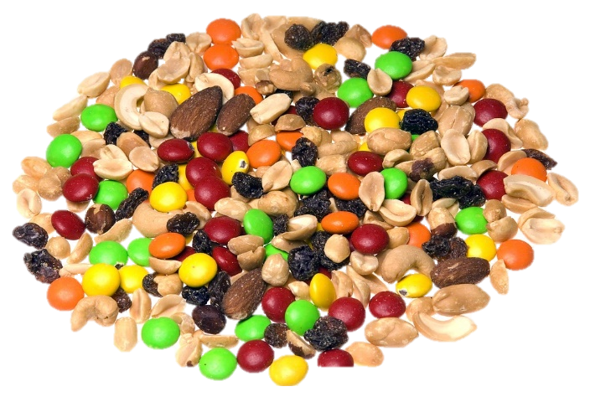
Pure Substances and Mixtures
Matter
Classification of Matter
Categories of Matter
Pure Substances
Mixtures
Solid
Liquid
Gas

Slide 2
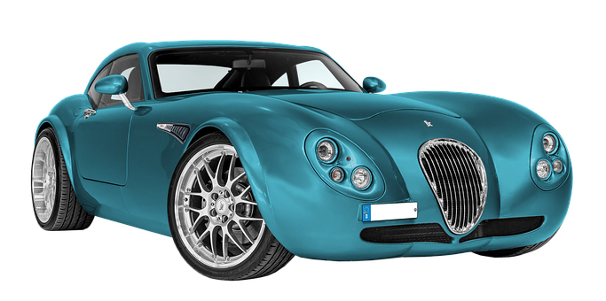
Matter
Matter – anything that has mass and takes up space
Mass – the amount of stuff (matter) inside an object
Almost everything is matter
Atoms, molecules, people, cars, planets, air, etc.
Energy is not matter
There are many types (states) of matter
There are two categories of matter

Slide 3
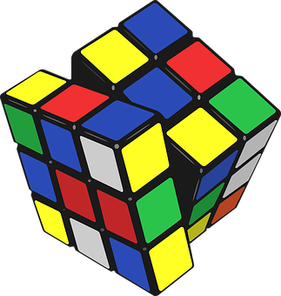
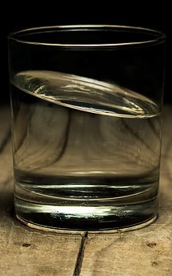
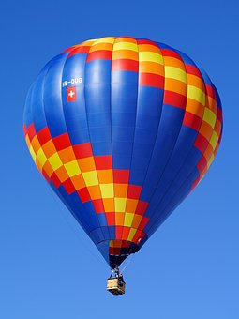
Classification of Matter
Three states
Solid
Substance keeps its shape and doesn’t flow
Liquid
Substance takes on the shape of its container and flows
Gas
Substance fills a container of any size/shape

Slide 4
States of Matter
Solid
Liquid
Gas

Slide 5
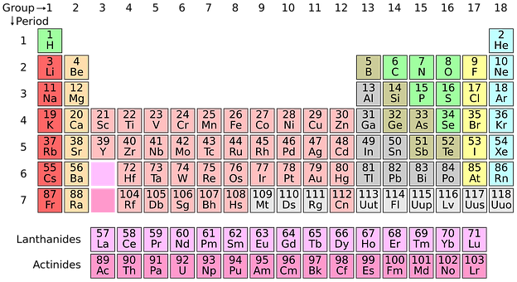
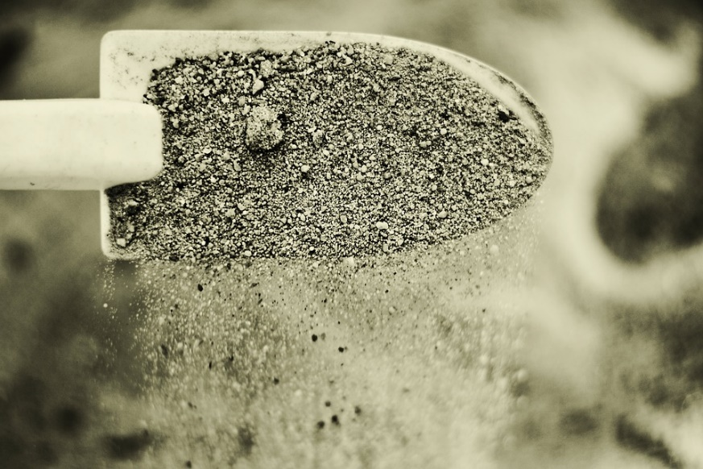
Categories of Matter
Pure Substances
Pure elements
Compounds (elements chemically bonded)
Mixtures
Physically, not chemically, combined

Slide 6
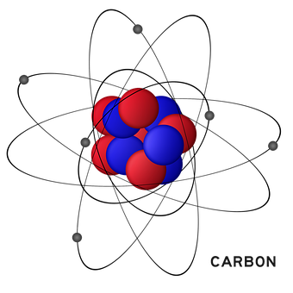
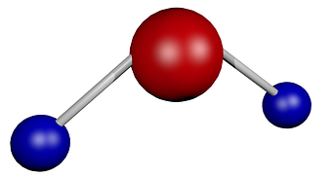
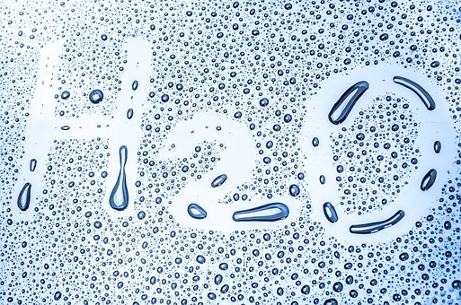
Pure Substances
Composition constant throughout
Bonds must be broken to separate

Slide 7
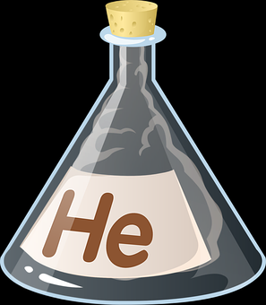
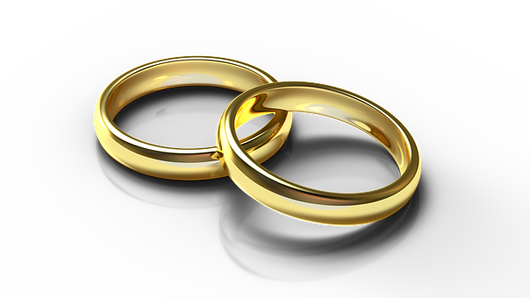
Elements
Make up matter
Single type of atom
Atom: the smallest particle of an element that still retains the properties of that element
All atoms of an element have the same number of protons
Cannot become another element by breakdown or chemical reaction

Slide 8
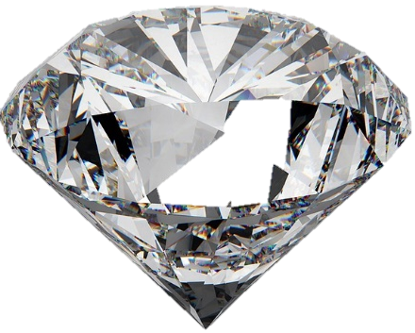
Elements
Diamond
Gold
Tin
Sulfur

Slide 9
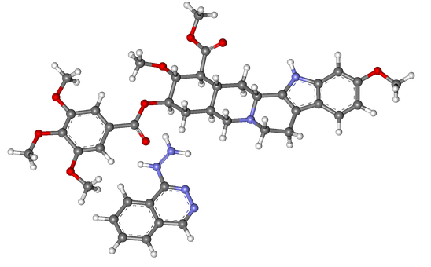
Compounds
Chemically bonded set of molecules or ions
Two or more elements
Constant ratio
Organic or inorganic
Organic: contain carbon or hydrogen
Inorganic: all others
Organometallic: carbon combined with a metal
Physical and chemical properties differ from components’
All compounds are substances, but not all substances are compounds

Slide 10
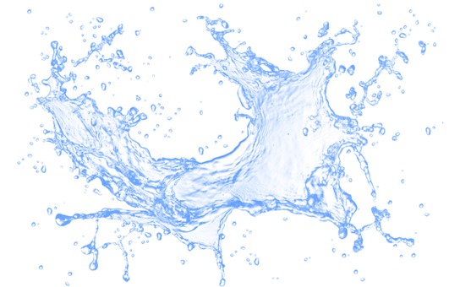
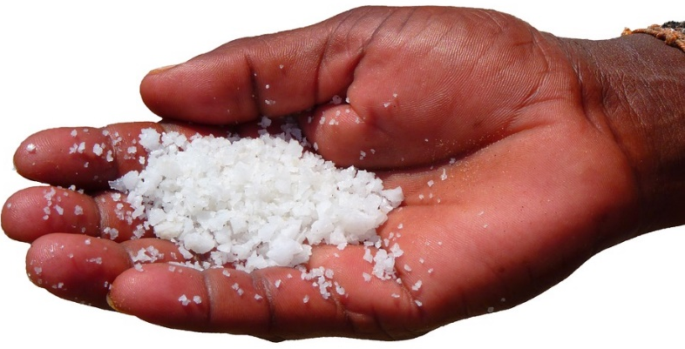
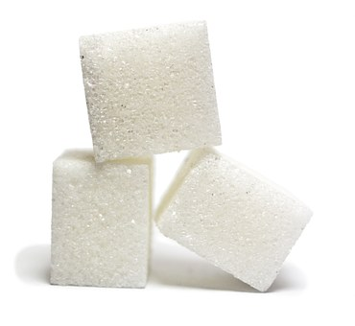
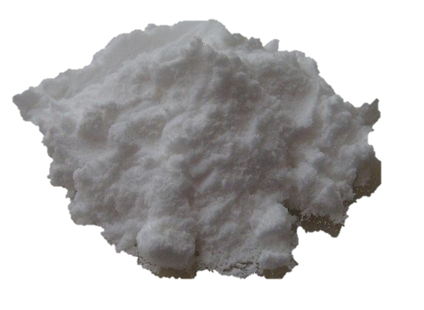
Compounds
Pure water
Dihydrogen monoxide
Table salt
Sodium chloride
Sugar
Sucrose
Baking soda
Sodium bicarbonate

Slide 11
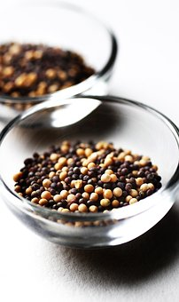
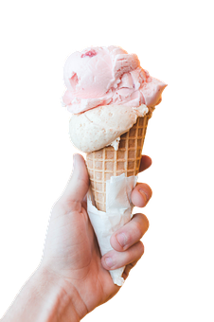
Mixtures
Composition not constant
Easily separated into components
Components retain identities
May have different physical properties than components (e.g. boiling point)
Forms
Alloys
Solutions
Suspensions
Colloids

Slide 12
Mixtures
Alloy
A metal and another element
Solution
Components uniformly mixed (homogenous)
Suspension
Small particles are suspended in the other component and can settle out
Colloid
Particles between 1 and 1000 nanometers evenly distributed within the other component

Slide 13
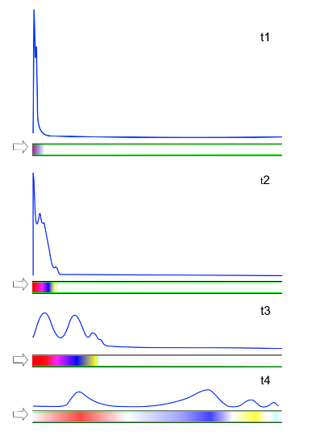
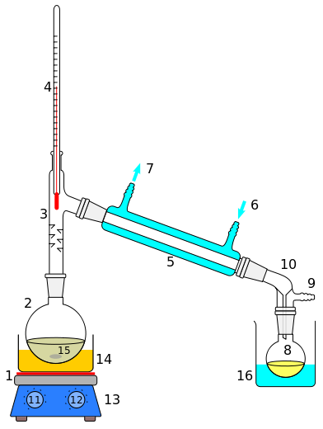
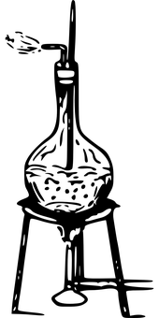
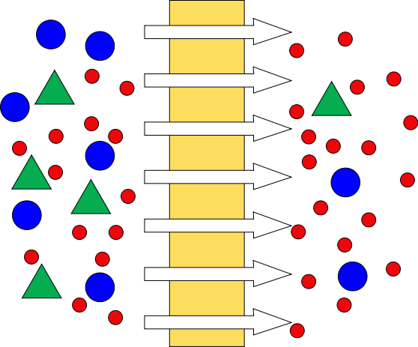
Mixtures
Separation methods
Chromatography
Separation by relative amounts between mobile and stationary phase
Distillation
Conversion to a vapor and back to a liquid
Evaporation
Addition of energy until liquid enters gaseous state
Filtration
Solid particles filtered out of liquid or gas because fluid can pass through filter

Slide 14
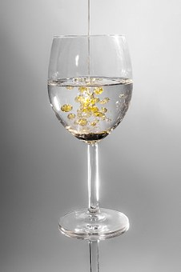
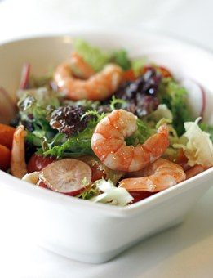
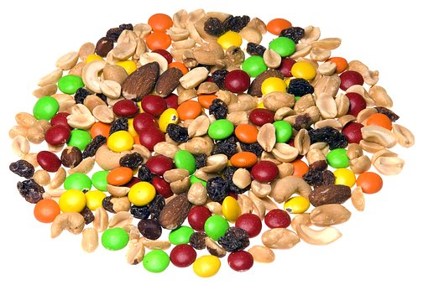
Heterogeneous Mixtures
Different components can be seen
Easy to separate physically (e.g. filtration)
Examples
Sand and water
Water and oil
Salad
Trail mix

Slide 15
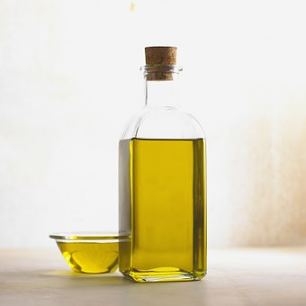
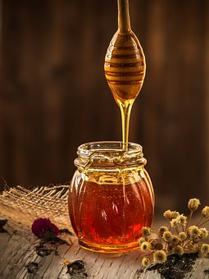
Homogeneous Mixtures
Uniform
Same properties throughout
Cannot see individual components
Examples
Olive oil
Honey
Air
Outside of chemistry, homogeneous mixtures are sometimes considered pure substances

